Slide 1

Crucial Conversations:
Cracking the Code
Chapters 1-5

Slide 3

Imagine …what would you do?
Clam up
Change the subject
Walk away
Get angry/aggressive/forceful
Use sarcasm
Give in
…Become an effective, assertive communicator?
Notes:
Scenarios:
-your work is being criticized
-you ask for some time off and your boss says “no”
-you ask for help and receive a dismissal or scolding
-you hear coworkers gossiping

Slide 4

What is a crucial conversation?
Any conversation in which…
  the stakes are high
  opinions vary
  emotions are strong

Slide 5
The “one thing”
Dialogue – the free flow of meaning between two or more people
  getting all relevant information out in the open
But how?
  Well, fortunately, that is the point of this book

Slide 6
“Although it’s true there are times when we are merely bystanders in life’s never-ending stream of head-on collisions, rarely are we completely innocent.”

Slide 7

Sucker’s choice: a false dichotomy
“In order to justify an especially sordid behavior, we suggest that we’re caught between two distasteful options.”
  But what about option #3? Have the crucial conversation!
Notes:
E.g. Either I tell this person off or I am going to have do what they want. Either I don’t say anything or I risk getting fired. Either I just deal with her behavior or I lose her as a friend.

Slide 8
How to stay focused on what you really want
Ask yourself:
  What do I really want for myself from this conversation?
  What do I really want for others?
  What do I really want for this relationship?
  How would I behave if I really wanted these results?
Notes:
What do I really want for myself from this conversation? Was it to achieve a goal or win an argument
What do I really want for others? Do I want to get their input or make them give in to my opinion
What do I really want for this relationship? Do I want respect and future conversations, or do I want to establish a different pattern of behavior
How would I behave if I really wanted these results?

Slide 9
How to stay focused on what you really want
Ask yourself:
  What do I really want for myself from this conversation?
    What do I really NOT want?
    What are you afraid will happen?
    What evidence are you basing that conclusion on?

Slide 10

Spotting “safety” issues
Silence- withholding information
  masking, avoiding, withdrawing
Violence- forcing information
  controlling, labeling, attacking
Notes:
Masking – understating or selectively showing your true opinions, e.g. sugarcoating
Avoiding – steering completely away from from sensitive subjects
Withdrawing – pulling out of a conversation altogether
Controlling – coercing others to your way of thinking
Labeling – putting a label on people or ideas so we can dismiss them under a general stereotype or category
Attacking – self explanatory

Slide 11
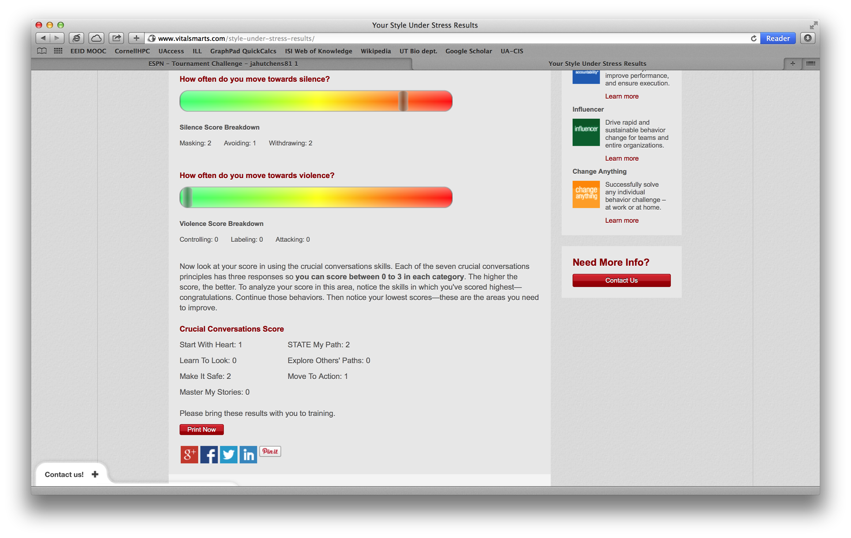
Your “Style Under Stress”

Slide 12

Recognize when you or others don’t feel “safe” in a conversation
Step away from the content and focus on establishing “safety”
State your intent/goal for the conversation
  Is there a mutual purpose?
    If not, you might see debate, defensiveness, suspect hidden agendas, accusations, or circling back to the same topics

Slide 13

How to find mutual purpose?
Apologize: sincerely express regret for your role in the situation
Contrast: don’t/do statement to clarify intent
  “Don’t” addresses a misunderstanding
  “Do” addresses the issue of mutual purpose or mutual respect

Slide 14
How to find mutual purpose?
CRIB method:
  Commit to seek mutual purpose
  Recognize the purpose behind the strategy
  Invent a mutual purpose
  Brainstorm new strategies

Slide 15
Next time: Getting what you want
Chapters 6-8
  What to do when you get mad, worried, or offended…
  How to best explain your point of view…
  How to listen, even when you might not want to…

Slide 16
Announcements: Upcoming events
Natural Resource Graduate Student Organization (NRGSO) invited speaker
Ms. Morgan Heim, speaking on "Like Sweaters for Penguins: A guidebook on how to bring good storytelling to your science and expand your reach”
WINS meeting with Ms. Heim on Tuesday, April 1st from 2:30-3:30, BSE 311

Slide 17
Announcements: Upcoming events

